Slide 1
THE LOGIC OF COMPOUND STATEMENTS
SESSION 1-4
Course : Z0184 - Discrete Mathematics
Effective Period : September 2017

Slide 2
These slides have been adapted from :
Susanna S.Epp. (2010). Discrete Mathematics with Applications.4th edition. Thomson Brooks/Cole. USA. ISBN: 9780534359454
Chapter 2
M.Morris, M. (2014). Logic and Computer Design Fudamentals. 4th edition. Pearson Education. USA.
ISBN 13: 978-1-292-02468-4
Chapter 1
Acknowledgement

Slide 3
On successful completion of this Course, students will be able to:
Learning Objectives
LO 1: Explain the logic of compound and quantified statements and how do to proof
LO 2: Explain and applying Set Theory, Counting method and Number Theory
LO 3: Explain Function, recursion, fuzzy set, Relations and Graph Theory
LO 4: Explain Trees & Graph theory and its application
LO 5: Explain Automata and graph its application in computer science

Slide 4
Logical Form and Logical Equivalence
Logic is a science of the necessary laws of thought, without which no employment of the understanding and the reason takes place.
—Immanuel Kant, 1785

Slide 5
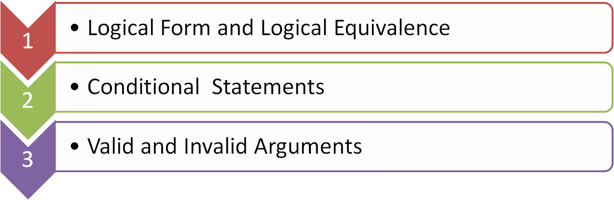
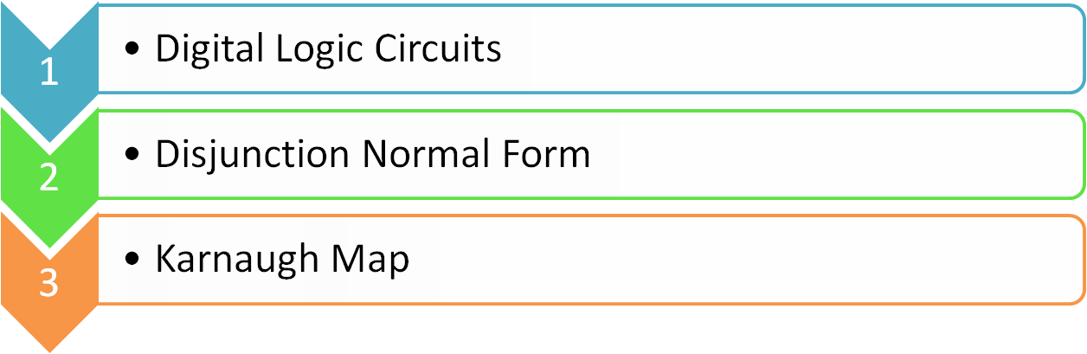
Outline

Slide 6
LOGICAL FORM AND LOGICAL EQUIVALENCE

Slide 7
Statements
Definition
A statement (or proposition) is a sentence that is true or false but not both.
Propositions | Not Propositions
3 + 2 = 32 | Bring me coffee!
5 – 2 = 3 | x + y > 0
Every cow has 4 legs. | 3 + 2
There is other life in the universe. | Do you like Cake?

Slide 8

Negation
Definition
If p is a statement variable, the negation of p is "not p" or "It is not the case that p" and is denoted ~p.

Slide 9

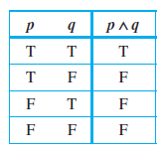
Conjunction
Definition
If p and q are statement variables, the conjunction of p and q is "p and q" denoted p q.
It is true when, and only when, both p
and q are true. If either p or q is false,
or if both are false, p q is false.

Slide 10
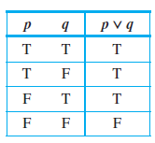
Disjunction
Definition
If p and q are statement variables, the disjunction of p and q is "p or q," denoted p v q.
It is true when either p is true, or q
is true, or both p and q are true; it is
false only when both p and q are
false.

Slide 11
A Statement Form (Proposition)
Definition
A statement form (or propositional form) is an expression made up of statement variables (such as p, q, and r) and logical connectives (such as ~, , and v) that becomes a statement when actual statements are substituted for the component statement variables.
The truth table for a given statement form displays the truth values that correspond to all possible combinations of truth values for its component statement variables.

Slide 12
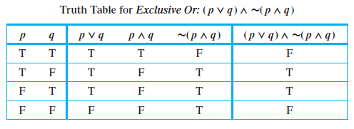
Example :
Truth Table for Exclusive Or

Slide 13
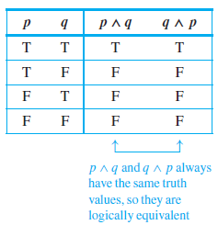
Logical Equivalence
Definition
Two statement forms are called
logically equivalent If and only if,
they have identical truth values for
each possible substitution of
statements for their statement
variables. The logical equivalence
of statement forms P and Q is
denoted by writing P ≡ Q.

Slide 14
Example: Logical Equivalence
Distributivity: p ∨ (q ∧ r) ≡ (p ∨ q) ∧ (p ∨ r)
p | q | r | q ∧ r | p ∨ (q ∧ r) | p ∨ q | p ∨ r | (p ∨ q) ∧ (p ∨ r)
T | T | T | T | T | T | T | T
T | T | F | F | T | T | T | T
T | F | T | F | T | T | T | T
T | F | F | F | T | T | T | T
F | T | T | T | T | T | T | T
F | T | F | F | F | T | F | F
F | F | T | F | F | F | T | F
F | F | F | F | F | F | F | F

Slide 15
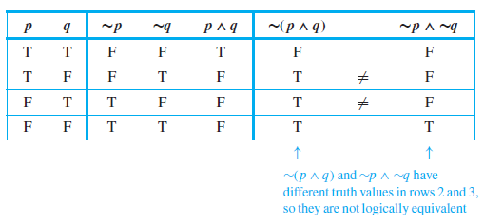
Showing Nonequivalence
Show that the statement forms ∼(p ∧ q) and ∼p ∧ ∼q are not logically equivalent

Slide 16
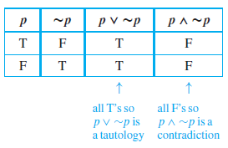
Tautology and Contradiction
Definition
A tautology is a statement
form that is always true.
A statement whose form is
a tautology is a tautological
statement.
A contradiction is a statement form that is always false.
A statement whose form is a contradiction is a contradictory statement.

Slide 17
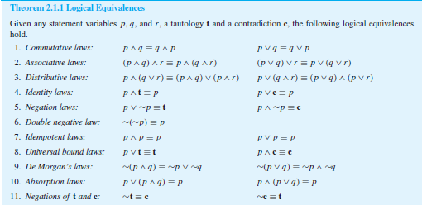
Summary of Logical Equivalences

Slide 18

Simplifying Statement Forms
Example : Use Theorem 2.1.1 to verify the logical equivalence
∼(∼p ∧ q) ∧ (p ∨ q) ≡ p.
Solution:

Slide 19
CONDITIONAL STATEMENTS

Slide 20
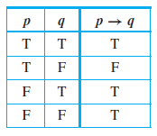
Conditional Statements
(Implication)
Definition
If p and q are statement variables,
the conditional of q by p is
"If p then q" or "p implies q" and is
denoted p → q. It is false when p is
true and q is false; otherwise it is
true.

Slide 21

The Negation of a Conditional Statement
Example : Write negations for each of the following statements:
a. If my car is in the repair shop, then I cannot get to class.
b. If Sara lives in Athens, then she lives in Greece.
Solution :
a. My car is in the repair shop and I can get to class.
b. Sara lives in Athens and she does not live in Greece. (Sara might live in Athens,
Georgia; Athens, Ohio; or Athens, Wisconsin.)

Slide 22
The Contrapositive, Converse and
Inverse of a Conditional Statement
Definition
Suppose a conditional statement of the form “If p then q” is given.
The contrapositive is “If ~q then ~p” (~q → ~p)
The converse is “If q then p“ (q → p)
The inverse is "If ~p then ~q" (~p → ~q)

Slide 23
The Contrapositive, Converse and
Inverse of a Conditional Statement
Example :
Write each of the following statements in its equivalent contrapositive , Convers and Inverse form:
a. If Howard can swim across the lake, then Howard can swim to the island.
b. If today is Easter, then tomorrow is Monday.

Slide 24
The Contrapositive, Converse and
Inverse of a Conditional Statement
Solution
Contrapositive : If Howard cannot swim to the island, then Howard cannot swim across the lake.
Converse: If Howard can swim to the island, then Howard can swim across the lake.
Inverse: If Howard cannot swim across the lake, then Howard cannot swim to the island.
b. Contrapositive : If tomorrow is not Monday, then today is not Easter.
Converse: If tomorrow is Monday, then today is Easter.
Inverse: If today is not Easter, then tomorrow is not Monday

Slide 25

Biconditional (Biimplication)
Definition
Given statement variables p and q,
the biconditional of p and q is "p if
and only if q" and is denoted p ↔ q.
It is true if both p and q have the
same truth values and is false if p
and q have opposite truth values.
The words if and only if are sometimes abbreviated iff.

Slide 26
VALID AND INVALID ARGUMENTS

Slide 27

Valid and Invalid Arguments
Definition
An argument is a sequence of statements (or proposition). All statements (or proposition) in an argument except for the final one, are called premises (or assumptions or hypotheses). The final statement or statement form is called the conclusion.
The symbol ∴ , which is read "therefore," is normally placed just before the conclusion.
To say that an argument is valid means that if the resulting premises are all true, then the conclusion is also true.

Slide 28
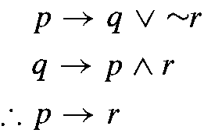
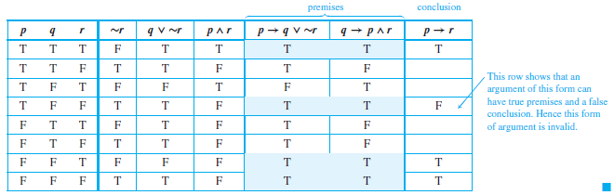
An Invalid Argument Form
Show that the following argument form is invalid.

Slide 29
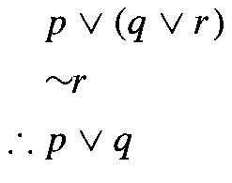
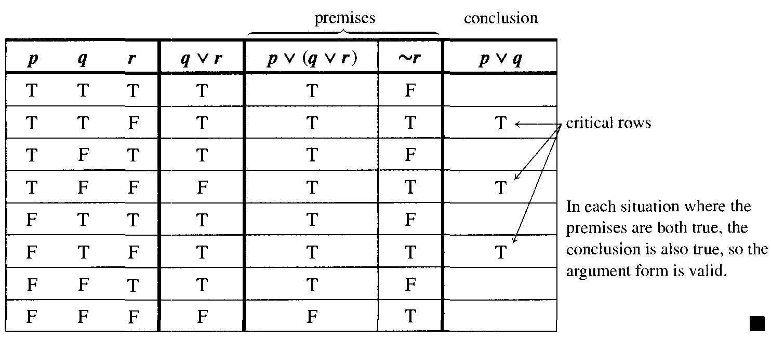
A Valid Argument Form
Show that the following argument form is valid

Slide 30
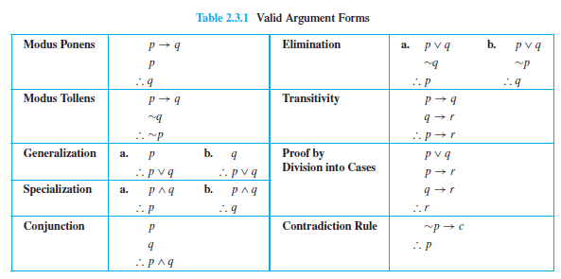
Rules of Inference

Slide 31
Application: A More Complex Deduction
You are about to leave for school in the morning and discover that you don’t have your glasses. This statements are true:
a. If I was reading the newspaper in the kitchen, then my glasses are on the kitchen table.
b. If my glasses are on the kitchen table, then I saw them at breakfast.
c. I did not see my glasses at breakfast.
d. I was reading the newspaper in the living room or I was reading the newspaper in the kitchen.
e. If I was reading the newspaper in the living room then my glasses are on the coffee table.
Where are the glasses?

Slide 32
Application: A More Complex Deduction
Solution :
Let
RK = I was reading the newspaper in the kitchen.
GK = My glasses are on the kitchen table.
SB = I saw my glasses at breakfast.
RL = I was reading the newspaper in the living room.
GC = My glasses are on the coffee table.

Slide 33
The conclusion
1. RK → GK by (a)
GK → SB by (d)
∴ RK → SB by transitivity
2. RK → SB by the conclusion of (1)
∼SB by (c)
∴ ∼RK by modus tollens
3. RL ∨ RK by (d)
∼RK by the conclusion of (2)
∴ RL by elimination
4. RL → GC by (e)
RL by the conclusion of (3)
∴ GC by modus ponens
∴ Thus the glasses are on the coffee table.

Slide 34
Exercises
Use symbols to write the logical form of each argument and then use a truth table to test the argument for validity.
a. If Tom is not on team A, then Hua is on team B.
If Hua is not on team B, then Tom is on team A.
.'. Tom is not on team A or Hua is not on team B.
b. Oleg is a math major or Oleg is an economics major.
If Oleg is a math major, then Oleg is required to take Math 362.
.'. Oleg is an economics major or Oleg is not required to take Math 362.

Slide 35
DIGITAL LOGIC CIRCUITS

Slide 36
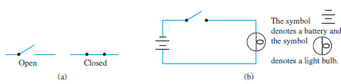
Application: Digital Logic Circuits
The drawing in Figure (a) shows the appearance of the two positions of a simple switch. When the switch is closed, current can flow from one terminal to the other; when it is open, current cannot flow. Imagine that such a switch is part of the circuit shown in Figure (b). The light bulb turns on if, and only if, current flows through it. And this happens if, and only if, the switch is closed.

Slide 37
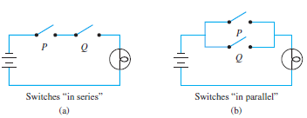
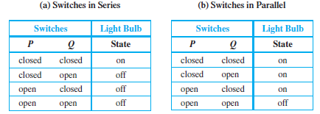
Application: Digital Logic Circuits
Now consider the more complicated circuits :

Slide 38

Black Boxes and Gates
The operation of a black box is completely specified by constructing an input/output table that lists all its possible input signals together with their corresponding output signals.

Slide 39
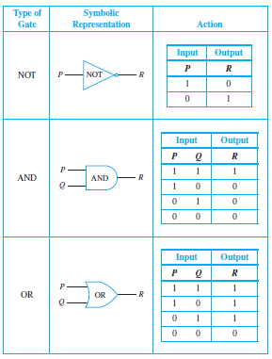
“NOT”, “AND”, and “OR” Gates

Slide 40
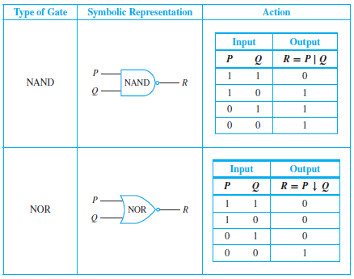
NAND and NOR Gates

Slide 41
Combinatorial Circuits
In circuitry theory, NOT, AND, and OR gates are the basic gates. Any circuit can be designed using these gates. The circuits designed depend only on the inputs, not on the output. In other words, these circuits have no memory. Also these circuits are called combinatorial circuits.

Slide 42
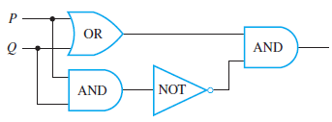
Finding a Boolean Expression for a Circuit
Find the Boolean expressions that correspond to the circuits shown below :
Solution :
The final expression obtained, (P ∨ Q)∧ ∼(P ∧ Q), is the expression for exclusive or: P or Q but not both.

Slide 43
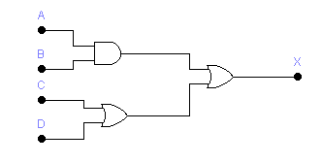
Example 1: Boolean Expression
AB
=AB+C+D
C+D

Slide 44
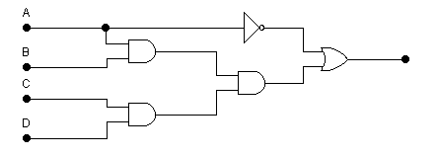
Example 2: Boolean Expression
A’
AB
A’+ABCD
ABCD
CD

Slide 45
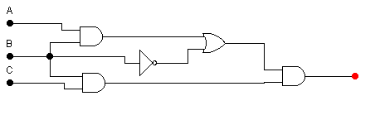
Example 3: Boolean Expression
AB
AB+B’
B’
(AB+B’)BC
BC

Slide 46
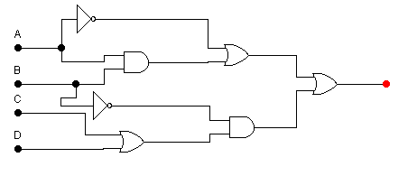
Example 4: Boolean Expression
A’
A’+AB
AB
A’+AB+B’(C+D)
B’
B’(C+D)
C+D

Slide 47
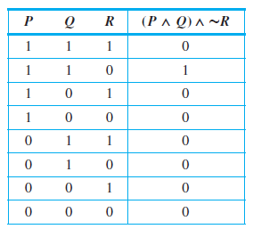
Recognizer
Definition
A recognizer is a circuit that outputs a 1 for exactly one particular combination of input signals and outputs 0’s for all other combinations.

Slide 48

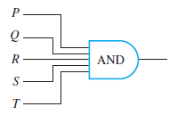
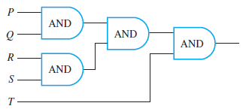
Constructing Circuits for Boolean Expressions
Construct circuits for the following Boolean expressions
Solution :
a multiple-input AND-gate

Slide 49
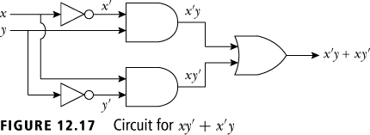
The Circuit Corresponding
to a Boolean Expression
The following example shows how to construct a circuit corresponding to a Boolean expression.

Slide 50
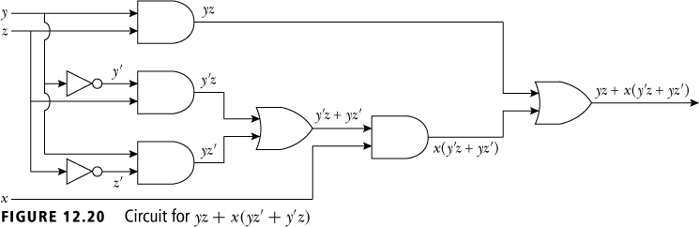
The Circuit Corresponding
to a Boolean Expression

Slide 51
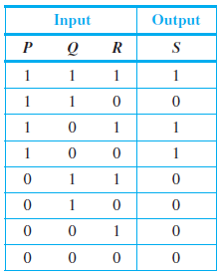
Designing a Circuit for a Given Input/Output Table
Design a circuit for the following input/output table:
Solution :
(P ∧ Q ∧ R) ∨ (P∧ ∼Q ∧ R) ∨ (P∧ ∼Q∧ ∼R).

Slide 52
Disjunctive Normal Form
(DNF)
Definition
Disjunctive Normal Form (DNF) is a boolean expression E, which has no duplication on the multiplication of each variable
Example
E1 = X Z’ + X’ Y Z’ + X Y’ Z is DNF
E2 = X Z’ + Y’ Z + X Y Z’ is not DNF, since the multiplication of XYZ’ including XZ’ (XZ’ is the first fundamental product of E2)

Slide 53
Full DNF
Definition
A boolean expression E (X1, X2, ...) is full DNF if each fundamental product of expression consisting of all the variables.
Example:
E = X Y 'Z + X' Y Z + X Y Z ‘
A DNF can be converted into full DNF as follows
E1 = X Z’ + X’ Y Z’ + X Y’ Z, then full DNF of E1 is
E1 = X Z’(Y+Y’) + X’ Y Z’ + X Y’ Z
= X Z’Y + XZ’Y’ + X’ Y Z’ + X Y’ Z

Slide 54
Consensus
Definition
Let P1 and P2 are fundamental product. If at least one variable which has complement on P1 and P2, then consensus (Q) from P1 and P2 is multiplication of each variables in P1 and P2 without complement variable.
Example
Let P1 = xy’zp and P2 = xyt, then consensus of P1 and P2 is Q = xzpt
Let P1 = xy’z and P2 = x’yzp, then P1 and P2 don’t have consensus because P1 and P2 have two complement variable, they are x and y.

Slide 55
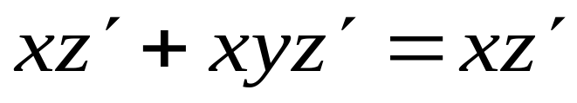
Theorem of Fundamental
Product
Theorem (Include)
If fundamental product P2 including fundamental product P1, then
P1+P2=P1
Example :

Slide 56
KARNAUGH MAP

Slide 57
Karnaugh Map
A Karnaugh Map is a grid-like representation of a truth table. It is really just another way of presenting a truth table, but the mode of presentation gives more insight. A Karnaugh map has zero and one entries at different positions. Each position in a grid corresponds to a truth table entry.
Given a Boolean function described by a truth table or logic function, then:
Draw the Karnaugh Mapfor the function.
Use the information from a Karnaugh Map to determine the smallest sum-of-products function.

Slide 58
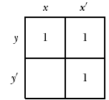
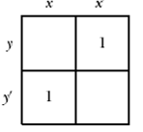
Karnaugh Map
Two Variables
Let α(x,y,) be a sum of product Boolean expression such that minterm consists of three variables x,y. To define the K-map for α(x,y) , we consider the following examples.
Example:
The left picture is the K-map corresponding to the α(x,y) = xy + x’y + x’y’
The left picture is the K-map corresponding to the
α(x,y) = x’y + xy’

Slide 59
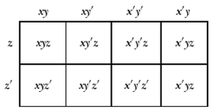
Karnaugh Map
Let α(x,y,z) be a sum of product Boolean expression such that minterm consists of three variables x,y,z. To define the K-map for α(x,y,z) , we consider the following table

Slide 60
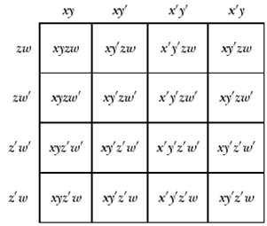
Karnaugh Map
Let α(x,y,z,w) be a sum
of product Boolean
expression such that
minterm consists of
three variables x,y,z,w.
To define the K-map
for α(x,y,z,w), we
consider the following
table

Slide 61
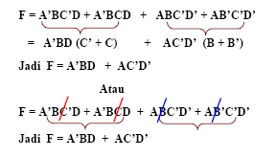
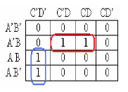
Literal Karnaugh Map
1. Pairs
or

Slide 62





Literal Karnaugh Map
2. Horizontal Quads
Karnaugh map above same as following Karnaugh Map

Slide 63




Literal Karnaugh Map
3. Vertical Quads
Karnaugh map above same as following Karnaugh Map

Slide 64




Literal Karnaugh Map
4. Octets (1/2)
Karnaugh map above same as following Karnaugh Map

Slide 65




Literal Karnaugh Map
4. Octets (2/2)
Karnaugh map in slide before same as following Karnaugh Map

Slide 66
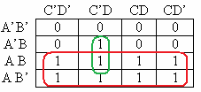
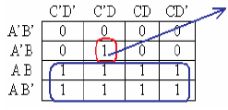
Literal Karnaugh Map
5. Overlapping
isolated
Avoid isolated “1”, because it can make logic expression cannot be simplified

Slide 67
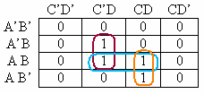
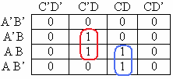
Literal Karnaugh Map
6. Redundant
redudant
Redundant should be erase to get simple boolean expression
F = A’BC’D + ABC’D + ABCD + AB’CD
= BC’D +ACD

Slide 68
References
Susanna S.Epp. (2015). Discrete Mathematics with Applications.5th edition. Thomson Brooks/Cole. USA. ISBN: 9780534359454
M.Morris, M. (2014). Logic and Computer Design Fudamentals. 4th edition. Pearson Education. USA.
ISBN 13: 978-1-292-02468-4

